Slide 1
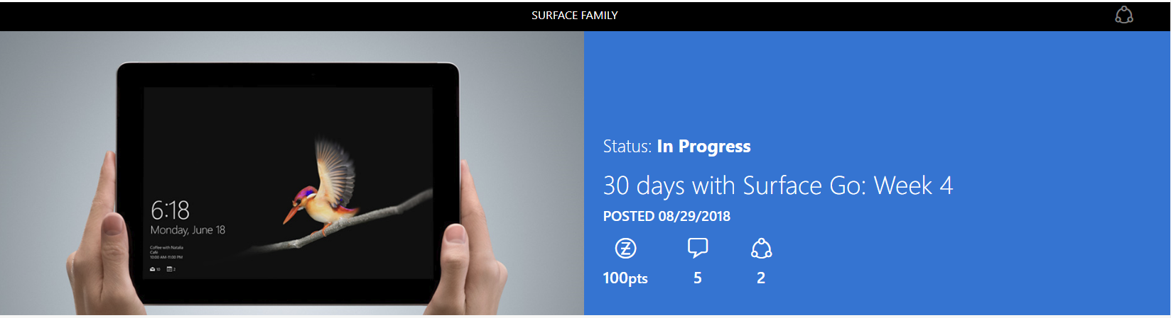
I've spent four weeks with Surface Go, using it for all of those things that come up throughout a day. When I started, I was curious to see how I would feel about this device at the end. What would I like most about Surface Go? Would it become an integral part of my day? Let's see what my final week was like!

Slide 2
Day 22: I (finally) catch up on Avengers: Infinity War
When my wife and I couldn't carve out time away from our newborn to see Avengers: Infinity War in theaters, I was determined to see it the moment it was available on our TV screen. After nearly three hours of watching Infinity War, I realized that I had MONTHS of articles to catch up on. Spoiler discussions, analysis, predictions of what comes next--all of it had been off-limits! But not tonight. I spent over an hour with Surface Go, going from website to website in Edge. I took full advantage of the ability to have tons of tabs open, of Reading View, and the fact that Surface Go is super comfortable to hold.
Day 23: I really enjoy Edge
I wondered what it would be like using Edge in Windows 10 in S Mode, so over the last 30 days I used it exclusively. Before using Surface Go, I really liked Edge, but the experience on Surface Go made me LOVE it. I pinned my regular sites--Inbox, Google Photos, and Hangouts--to my Start menu and taskbar, which launched a tab in Edge any time I opened them, exactly like you get on a Chromebook. It was easy to do, the icons were familiar, and I found it as useful as opening an app. But my two favorite Edge features ended up being able to set aside tabs and the ability to write on webpages that I can save to OneNote. I use both frequently, and miss them when I'm not in Edge.
Day 24: I use Skype to check in on my grandmother
I wasn't able to visit my grandmother in person this week, so I figured I'd do the next best thing--I'd Skype with her! I had my grandfather bring their budget Android tablet to her and log in to Skype, and I did the same on Surface Go. The camera was crystal clear and Surface Go was easy to hold the whole time, even as I was moving it around to get myself, my son, and my wife all in frame.

Slide 3
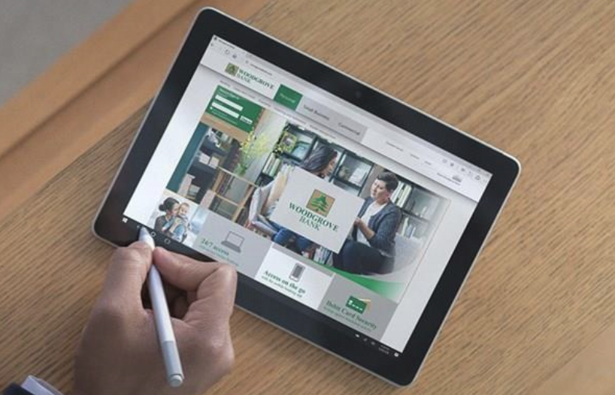
Day 25: I get kicked out of the kitchen
Both my wife and I love to cook...until we try to cook together. Could Surface Go change that? We pulled up a recipe on Surface Go, attached the Surface Pen to the side, and got started. I'd say we adjusted the kickstand to the perfect angle, but we each seemed to have a different idea of what that was. Good thing it's easy to adjust back and forth! And then...I was kicked out of the kitchen. It was still awesome to watch my wife use Surface Go to cross off things she'd done, scroll with touch, and use voice to ask Cortana for alternatives when she realized we were missing ingredients.
Day 26: I compete for my own TV
We had friends over for dinner, knowing the evening would end where it always does: sitting in front of a TV. It starts with one person playing a YouTube video that they think is hilarious, and eventually we're in a competition to see who can come up with the biggest reaction. The difference this time was that we passed around Surface Go, casting what we found in Edge to the Wireless Display Adapter connected to my TV. You got to see each person use Surface Go differently, showing in one night how versatile it is.
Day 27: I geek out
Once every few months, I head back to my hometown for a day to hang out with longtime friends. We eat, watch a movie, give each other a hard time, and playDestiny 2. While we play, I always end up using my phone a bunch, but this time I had Surface Go. It was SO much better using Surface Go to pull up a gameplay video that we could all see at the same time, or to see my in-game inventory and use the touchscreen to drag-and-drop items out of my inventory. I can never go back!
Day 28: I enlist some help...from 100 miles away
If you read my last article, you know I am on a mission to update my garage. One of the coolest parts of that process was using Microsoft Whiteboard on Surface Go to collaborate with my grandpa who lives 100 miles away. All I had to do was share a new whiteboard with him through email, and then we could sketch the layout, insert photos of storage products, and add notes. I took FULL advantage of Surface Go to come up with our plan. I drew out the dimensions of the garage using Surface Pen and I attached my Surface Go Type Cover to look up images of storage products. Surface Go made working together possible.

Slide 4
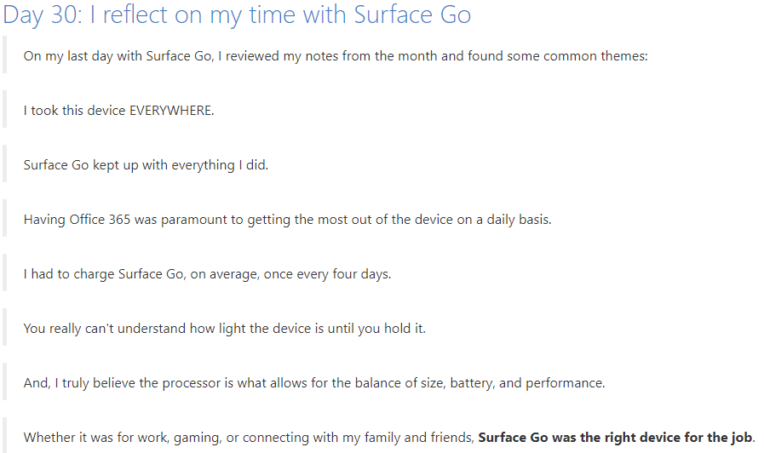
Day 29: I finally start my leagues
Every year, I run two fantasy football leagues, which I've been horribly behind on starting this year. So, with the help of Surface Go, I finally sat down and tackled the league setups in one night! First, I opened six tabs: a couple for each league, one for a random number generator so I could figure out draft order, and one for Gmail so I could email each league. Then, I wrote the season kick-off emails in Word. And, finally, I put together each team's player information in Excel.Surface Go handled all of this multi-tasking without ever slowing down. This device and the processor inside continue to impress!

