Slide 1
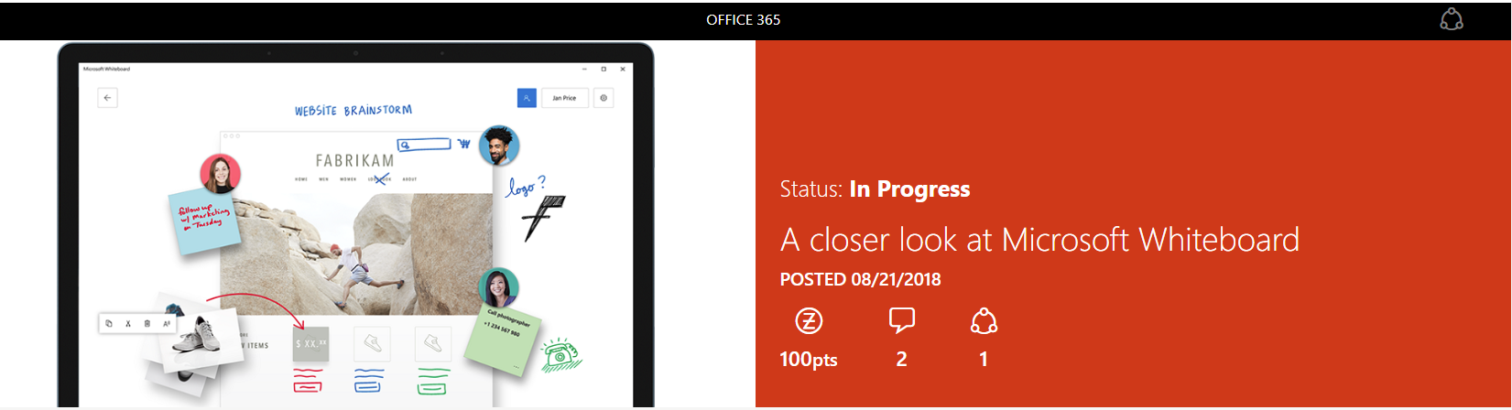
How can Microsoft Whiteboard help you or your customers brainstorm and collaborate better?

Slide 2
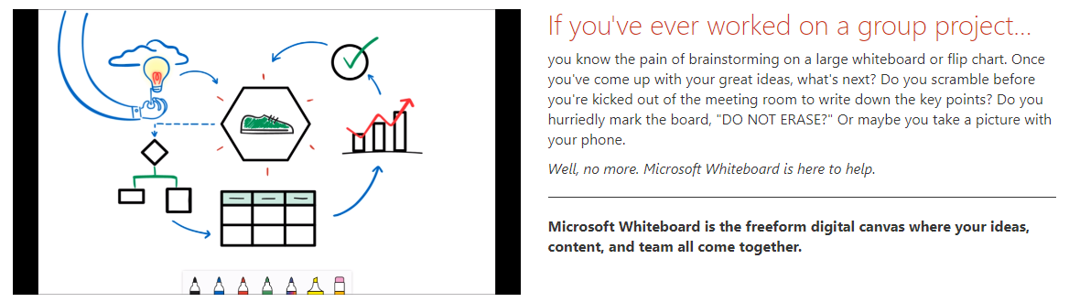
Collaborative brainstorming, evolved.

Slide 3
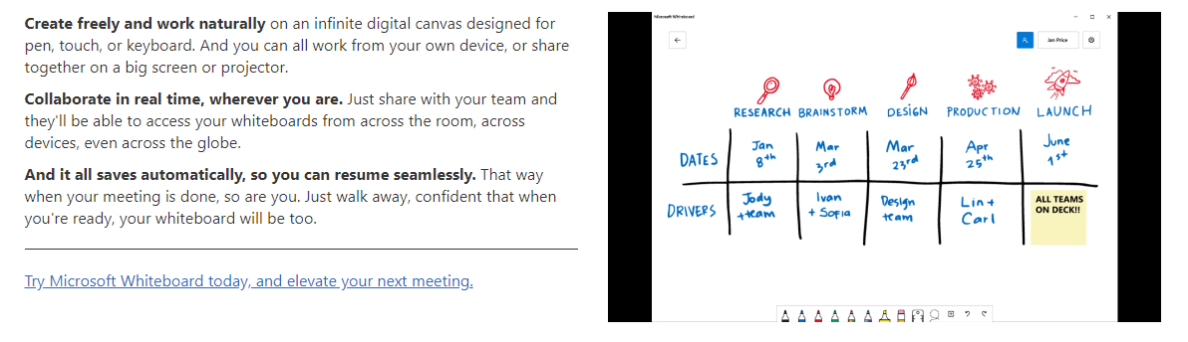
Collaborative brainstorming, evolved.

Slide 4
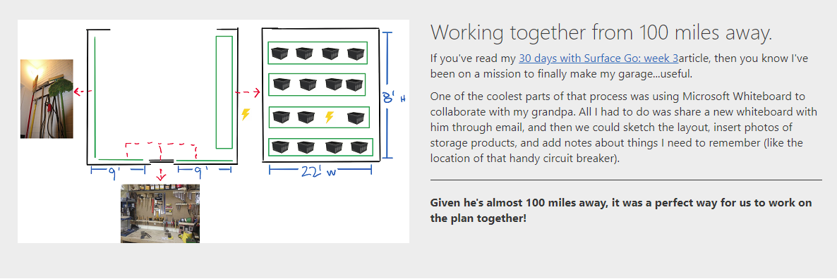
A real-world story from one of our own.
My fellow writer and Surface expert, has been trying Microsoft Whiteboard on his new Surface Go.

Slide 5
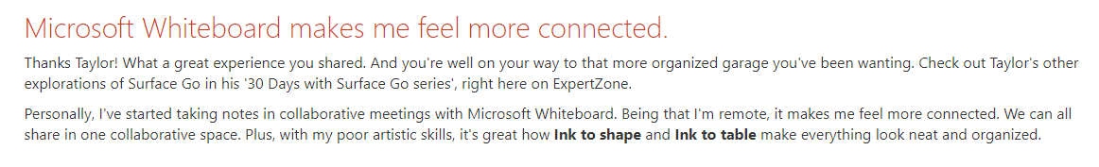
Microsoft Whiteboard is available for all regions in English only. It will roll out to other languages over the next few months, and will also be available for iOS and the web soon. To get started, simply download the app from the Microsoft Store on a Windows 10 device and log in with your Microsoft or Office 365 account.

