Slide 1

Admin Guide To App Studio
January 2021

Slide 2
Getting Started
Who is This Guide for?
REP 4.0 and/or MSFTREPS.com Administrators in each country
This guide assumes the Admin:
Has login/access to MSFTREPS.com
Currently assists/supports REP users (REPs) in their market
Is familiar with adding Users, Assigning stores to users and viewing and exporting reports
This guide assumes that the REP 4.0 apps are being used by Reps in the field
What Will This Guide Cover?
How to use the Application Studio
Control theme and banners for each partner
Assign icons to access forms, URLs, documents and more
How to create and administer a custom news feed
Some markets / countries will have both REP and Champions in App Studio. This guide will focus on the REP program experience.
Copyright © 2001, 2021 Westlake Software, Inc. Portions Copyright Microsoft Corp. All Right Reserved. Confidential Information.

Slide 3
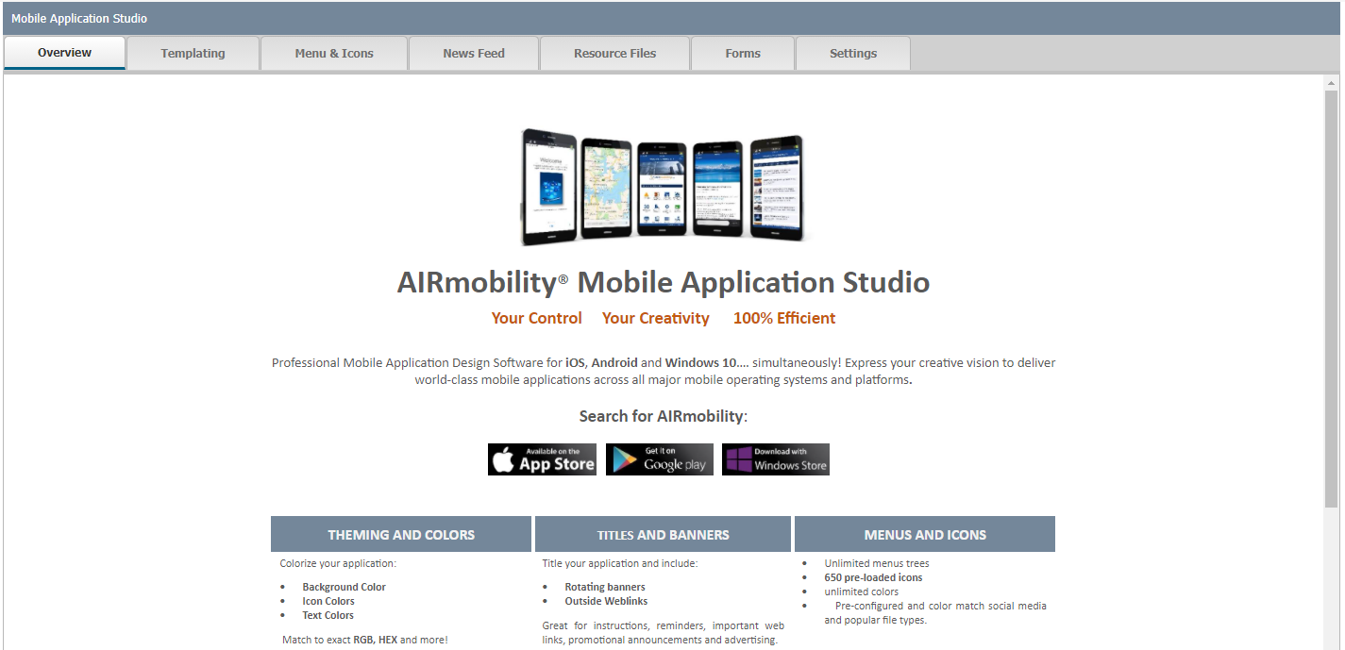
1. Application Studio - Overview
The Application Studio is a set of tools in which enables you to fully customized/design the user experience with the app.
You can define a theme color (match to a partner), add customized banners, defined icons and functions behind icons, re-order and organize icons, translate and much more.
NOTE – Microsoft REP Global Admin must activate all the features in the App Studio for you to use what is shown here. Send requests to Msftreps@microsoft.com.
Copyright © 2001, 2021 Westlake Software, Inc. Portions Copyright Microsoft Corp. All Right Reserved. Confidential Information.

Slide 4
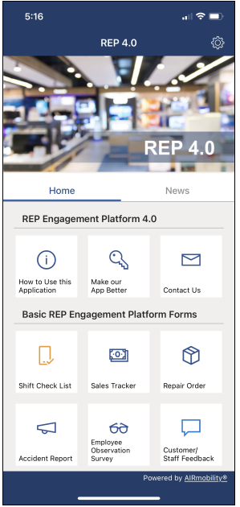
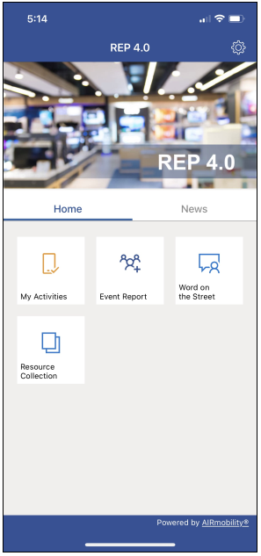
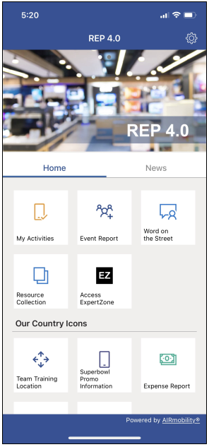
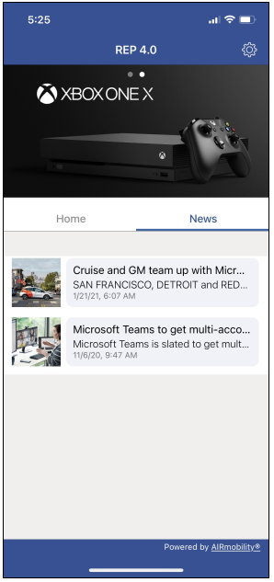
3. Application Studio – App Defaults
APP STORES DEFAULT
YOUR/ADMIN STARTING POINT
Generic Content was added to the store defaults; none of that sample content matters to your program.
Some global content has been added to your account starting point (second screen), so you are not starting at zero.
Examples of REP 4.0 configurations after Admin edits.
Copyright © 2001, 2021 Westlake Software, Inc. Portions Copyright Microsoft Corp. All Right Reserved. Confidential Information.

Slide 5
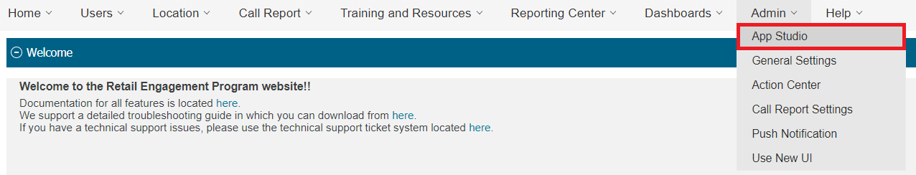
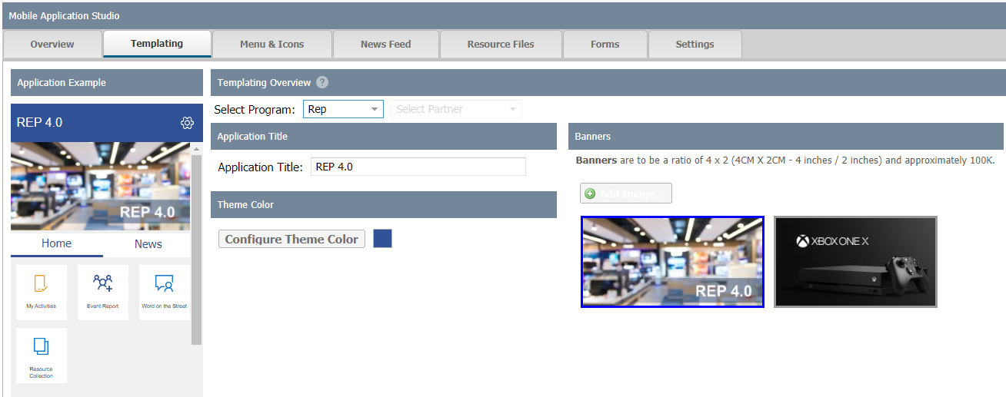
3. Application Studio – Orientation
App Studio is located as the first option under the Admin menu drop down.
Menus and Icons Content control of the app
New Feed
Make your own news feed/channel
Resource Files New/Easy way to manage documents
Forms
New/Easy way to manage Forms + Content
Settings
Some basic settings options
Templating
Theme Color, Title, Banners
Program Select
Look for this throughout the studio; REP and all Champions Partners are managed in the same User Interface
App Emulator
Shows what the app will generally look like
Copyright © 2001, 2021 Westlake Software, Inc. Portions Copyright Microsoft Corp. All Right Reserved. Confidential Information.

Slide 6
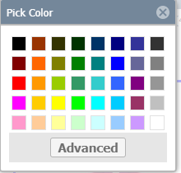
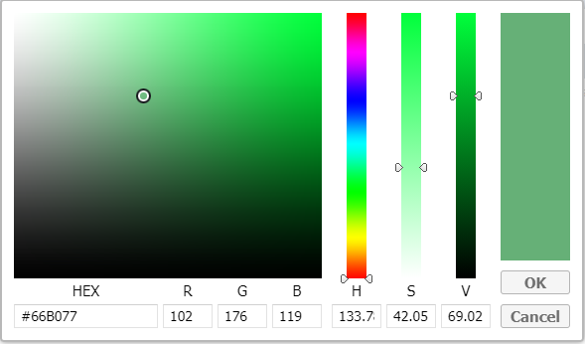
3. Application Studio – Templating
Templating enables you to (1) select between REP and Champions user experience. If Champions is not available in the market / country then Rep will be the only option.
Select Program: allows REP or Champion Program.**
Application Title. Enter in a local program Title (optional)
Theme Color – select a basic color or go advanced and match exact company or agency colors (optional)
4. Banner Image – best ratio is 4 X 4, JPG 100K or smaller. Larger files will take longer to load on the apps. To remove a banner, select with right mouse click. (Multiple images will scroll in the apps.)
**Selection is available for markets / countries with both REP and Champions. Others will not see this.
Copyright © 2001, 2021 Westlake Software, Inc. Portions Copyright Microsoft Corp. All Right Reserved. Confidential Information.

Slide 7
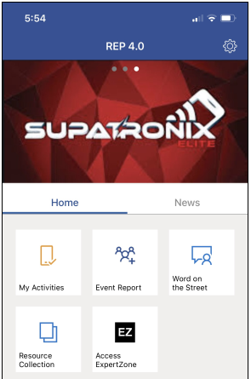
OPTIONAL App Studio – Templating Advanced
Matching colors exactly with partners logos and combining that with a custom banner can add a bigger wow factor to the REP Program. This is not required and, in some cases, will require some experience in graphic design.
Color Match
Screen capture the logo of your partner
Bring this into a graphics program (MS Paint will work)
Select the color; identify the RGB/HEX color
Select Theme color on Templating, Select Advanced
Enter in the RGB or HEX colors of the Logo and Save
Banner Logo / Images
Capture and Crop the agency / company logo.
Create a PNG for transparency if desired
Format to 4 X 2. We suggest 1220 X 600 Pixels
Export at no more than 100K file size.
Upload into Templating
Copyright © 2001, 2021 Westlake Software, Inc. Portions Copyright Microsoft Corp. All Right Reserved. Confidential Information.

Slide 8
3. App Studio – Menus and Icons Overview
The most feature-rich part of the Application Studio is Menus and Icons. The studio enables you to custom-create icons, forms, links to documents, websites and more and do so for each by partners, title, or individuals.
You as the Admin can highly customize the user experience in many ways. Here are a few examples:
Icon/Function Added | What Might it be for? | Limited to:
Phone icon to dial a number. | Rep to call your organization with a question. | Reps assigned Partner A
URL icon to open a website | Icon to go to ExpertZone | Available to Everyone
Document icon to open a brochure | Promotion about Xbox for the holidays | Just Reps with a certain title
Email icon to open email on your phone. | Email support from your agency | Available to Everyone
GPS icon to map a location. | Location of offsite training around new Windows announcement. | Reps assigned Partners A and B who were invited.
Copyright © 2001, 2021 Westlake Software, Inc. Portions Copyright Microsoft Corp. All Right Reserved. Confidential Information.

Slide 9
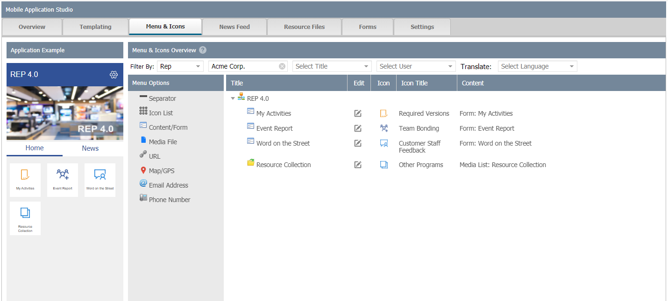
3. App Studio – Menus and Icons Page Overview
The most feature-rich part of the Application Studio is Menus and Icons. The studio enables you to custom-create icons, forms, links to documents, websites and more and do so for each by partners, titles, or individuals. The next few pages are a step-by-step tutorial on adding a basic icon, plus everything below in more detail.
Program
REP or Champions*
Partner
Select after Program
Select Title
See items assigned by title
Users
See items assigned by User
Translate
Support translations of text under icons
Icon Options
Drag these items to the right and drop
Edit
Advanced icon settings. Select icons, assignments, etc. This is where you can denote who sees what icon (person, titles, programs, etc.).
App Emulator
Shows what the app will generally look like
*Selection is available for markets / countries with both REP and Champions. Others will not see this.
Copyright © 2001, 2021 Westlake Software, Inc. Portions Copyright Microsoft Corp. All Right Reserved. Confidential Information.

Slide 10

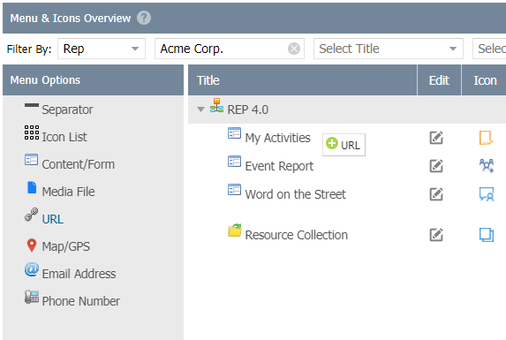
Tutorial - App Studio – Menus and Icons
How to add a URL icon to the app which will take me to the Microsoft Home Page on the Internet.
Step 1 – From the Menus and Icons Tab, select the URL Option shown below. Hold your mouse down on the words URL and drag this to the right onto the Title section. Look for the + URL indicator to show. You may need to move this up or down a little so the studio knows exactly where you want to place this. Once you have your spot, release your mouse.
Copyright © 2001, 2021 Westlake Software, Inc. Portions Copyright Microsoft Corp. All Right Reserved. Confidential Information.

Slide 11
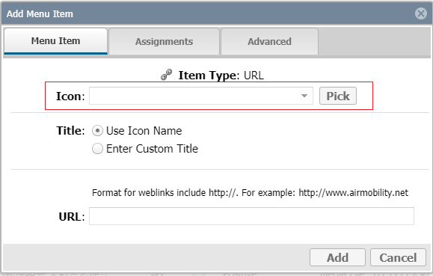
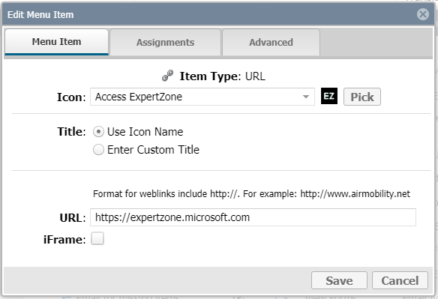
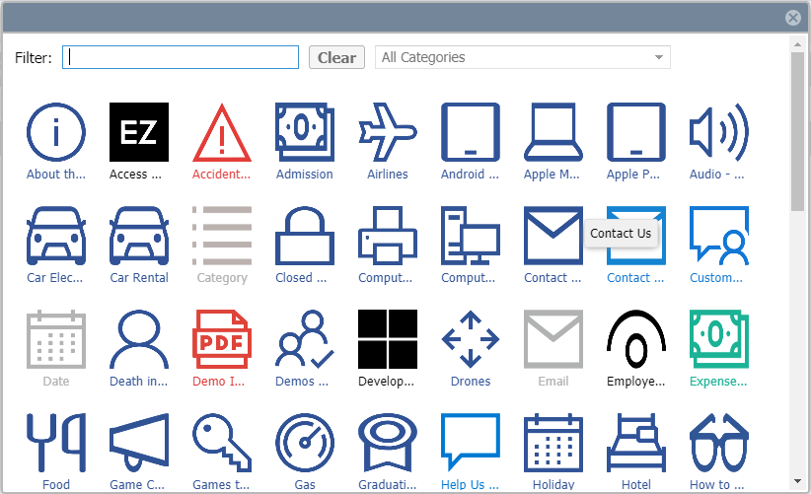

Tutorial - App Studio – Menus and Icons
Step 2 – When you release your mouse from the last page, a menu option will pop up.
On the Menu Items page:
Click the Pick icon button and find the icon called Microsoft Home
Change the title option form User Icon Name to Enter Custom URL
Type in Microsoft Home (you could leave this as the Icon Title as well; they are the same in this case, often they are not
Type in the URL using this format (http:// or https://): https://expertzone.microsoft.com
Select Save
Copyright © 2001, 2021 Westlake Software, Inc. Portions Copyright Microsoft Corp. All Right Reserved. Confidential Information.

Slide 12
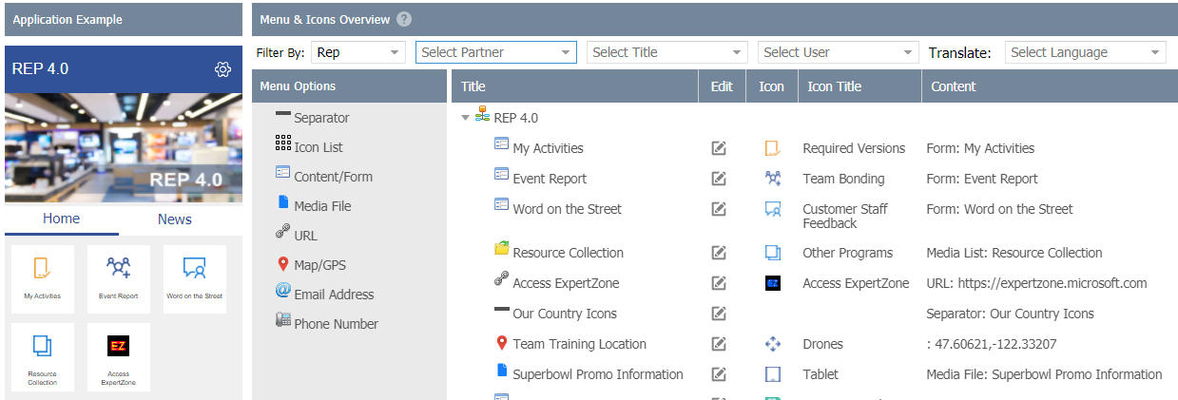

Tutorial - App Studio – Menus and Icons
The Icon is now displayed in the emulator on the left and has been added to your Titles on the right.
NOTE – if for some reason you do not see what you just added to the emulator, the system may have moved your icon to the very bottom of the list. It will do that if it can not interpret your drag and drop spot. It is easily moved. The Titles are also drag/drop ready, up and down.
Step 3 – Select the Edit Icon next to Access ExpertZone.
Copyright © 2001, 2021 Westlake Software, Inc. Portions Copyright Microsoft Corp. All Right Reserved. Confidential Information.

Slide 13
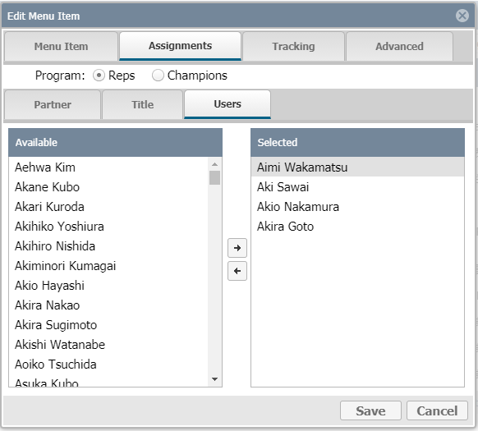
Tutorial - App Studio – Menus and Icons
Step 4 – Setting icon Assignments. Note – some Menu items will have a tab on them called Tracking. That is new feature coming and not documented here.
Click on the Assignments tab. Select if you want the Microsoft URL for REPs or for Champions.* Then pick if you want to assign this icon by Partner, Title or Users.
Drag the partners, titles or users to the right to assign this icon. Each tab updates based on hierarchy (moving left-to-right).
By doing so and selecting SAVE, that icon for Microsoft will be limited to just those selected. Drag back to the left to un-select.
*Selection is available for markets / countries with both REP and Champions. Others will not see this.
Copyright © 2001, 2021 Westlake Software, Inc. Portions Copyright Microsoft Corp. All Right Reserved. Confidential Information.

Slide 14
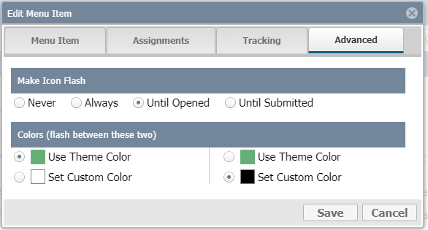
Tutorial - App Studio – Menus and Icons
Step 5 – Advanced (skip Tracking for now)
Advanced allows you to select two changing colors and make the icon flash/pulse. This provides the icon some visual importance when displayed in the app.
Options are:
Never (flash) default
Always
Until Opened
Until Submitted (form)
Select two different colors, save. Experiment.
Note: Use this selectively. Too many flashing icons can be visually overpowering in the program.
Copyright © 2001, 2021 Westlake Software, Inc. Portions Copyright Microsoft Corp. All Right Reserved. Confidential Information.

Slide 15

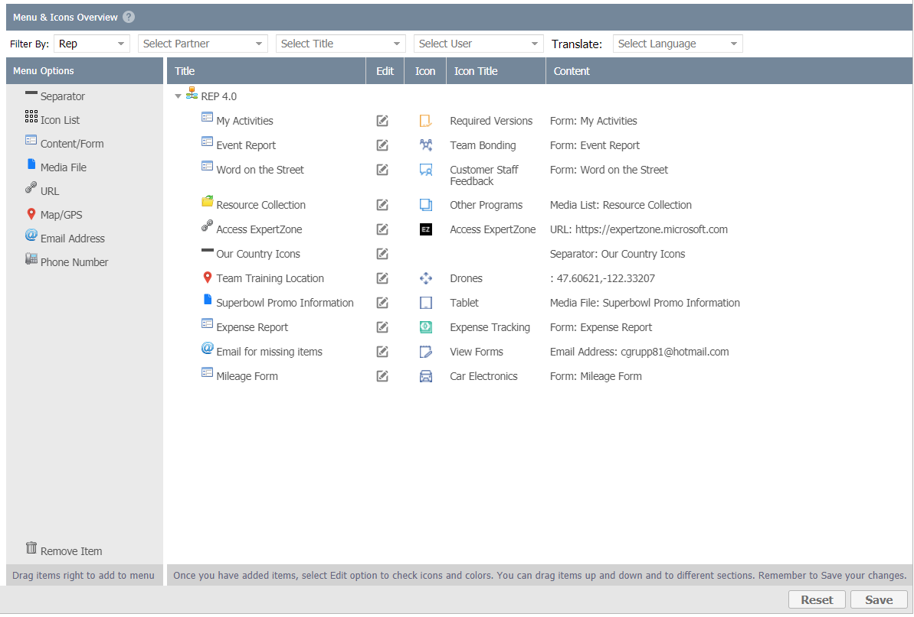
Tutorial - App Studio – Menus and Icons
Step 6 – Save your changes.
After adding your icons and making any edits, the final step is to Save. This will lock in your work and make them immediately visible on the app.
Copyright © 2001, 2021 Westlake Software, Inc. Portions Copyright Microsoft Corp. All Right Reserved. Confidential Information.

Slide 16
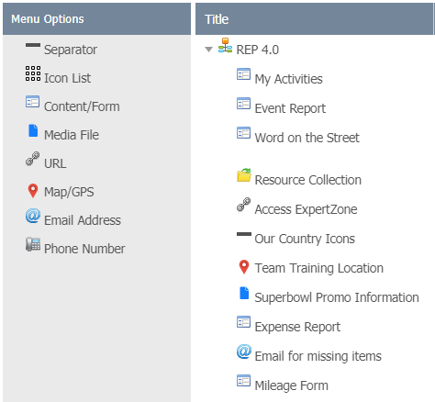
Tutorial - App Studio – Menu Options + Ordering
This breakout tutorial showed you how to add a URL to the app, select and icon for the URL, set assignments and showed the Advanced options to make the icon flash/pulse between two colors. Here is the full list of options supported behind each item you can add, as of January 2021.
Icon List
Create tiers/levels of icons. Add an icon list and then drag you other icons onto this item. This will place those icons onto a new page. You can add multiple levels down with this.
Separator
This option allows you to title and draw a line above a set of icons. This is technically not an icon but it will help you organize the user experience. When you add, you can also make a bar support a weblink if desired (ex., “click here for more info, etc.”).
Media File
As you add documents, graphics, etc. to the program, you can assign those resources to an icon. If you were to use the Icon List option above, you could for example (1) make an Icon List called Sales Documents, then support Media File Documents under that icon list.
Phone Number
For iOS and Android user, you can create an icon to dial a phone number. Maybe this is the contact at your agency? Numbers to dial other resources. NOTE: in some cases you may need the country code, etc. This has been tested in multiple countries but not all.
Email
This option will open the default email app on your Rep’s device to send an email to a specified address.
Mapping (new)
Enables you to enter in any LAT and LONG coordinates to trigger mapping on any device. We provide a global link to a service where you can type in any street address and enter in the coordinates.
Form/Content
You can assign any form you created to an icon. Forms can now be used to create information/content pages. This is useful for announcements, information, etc. This is covered in a section forward in this document.
Remove Item
Drag an option you created from the Title view BACK to the menus; drop right on Remove Item. This will remove the icon. Note, removing an icon does NOT delete or remove a form; just access to that form as that icon is no longer accessible.
Copyright © 2001, 2021 Westlake Software, Inc. Portions Copyright Microsoft Corp. All Right Reserved. Confidential Information.

Slide 17
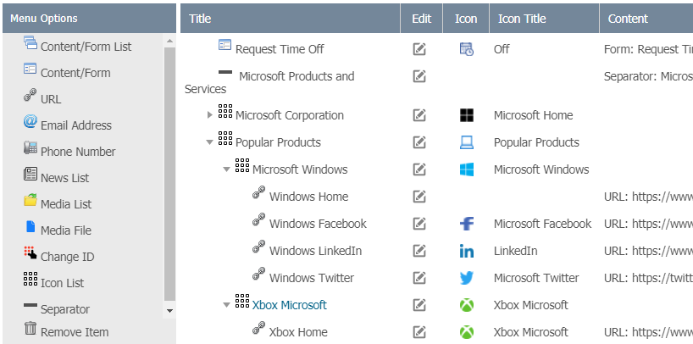
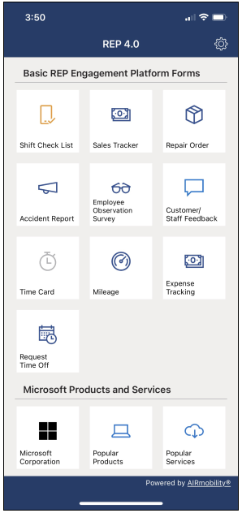
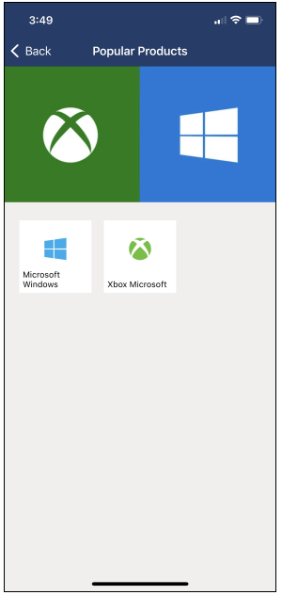
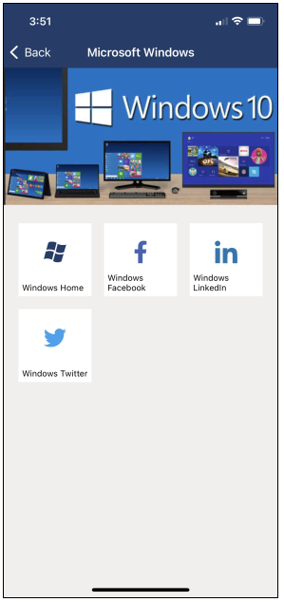
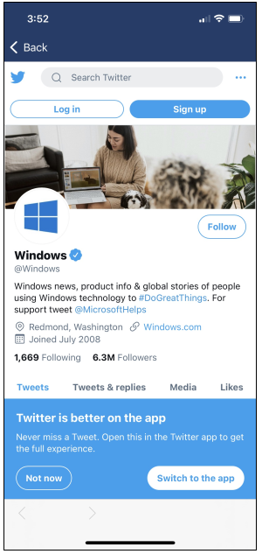
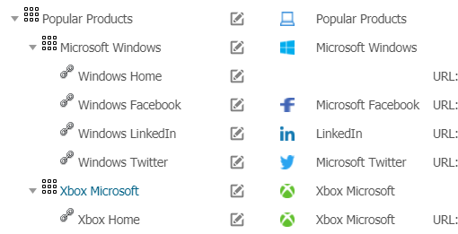
Tutorial - App Studio – Example
App information flow in the store-default REP apps in the stores today. The example takes the user from the main page of Microsoft Products to selecting a product and choose direct access to the home page and social media for those products.
As you can see above:
Popular Products – Icons List
Microsoft Windows – Icon List
Windows Twitter – URL
This matches the titles, icons and workflow to the right.
Popular Products – Icon List to support (1) Microsoft Windows and (2) Xbox.
Windows & Xbox – These were also added as Icon Lists to support a collection of social media links.
Windows Links – These four items were added as URL links to those services.
iframe – Note the back option with a URL displayed; stays within the app.
Copyright © 2001, 2021 Westlake Software, Inc. Portions Copyright Microsoft Corp. All Right Reserved. Confidential Information.

Slide 18
3. App Studio – Menus and Icons – Filter Bar
The Filter Bar enables you to see an Icon list representation of what a partner might see as well as who is assigned what icon and in what view. For example, you may have a document for one partner and a similar but different document for another partner. You can load both documents and then assign them separately in the studio. Then use the drop down menus below to get a better view/visual of what is being provided.
Filter By Program*:
Drop down to see what is assigned to the REP program view or the Champions View.
*Available for markets / countries with both REP and Champions. Others will not see this.
Filter by Partner
Drop down to see what is assigned by partner.
Filter by Title
See what icons have been assigned by title.
Filter by User
See what icons have been assigned to users.
You could assign a single icon (document, form, phone number) to a single user.
Translate
Open a table by any language and translate the text under each icon.
Note: These controls offer different views in the Emulator and the items assigned. No edits are made.
Copyright © 2001, 2021 Westlake Software, Inc. Portions Copyright Microsoft Corp. All Right Reserved. Confidential Information.

Slide 19
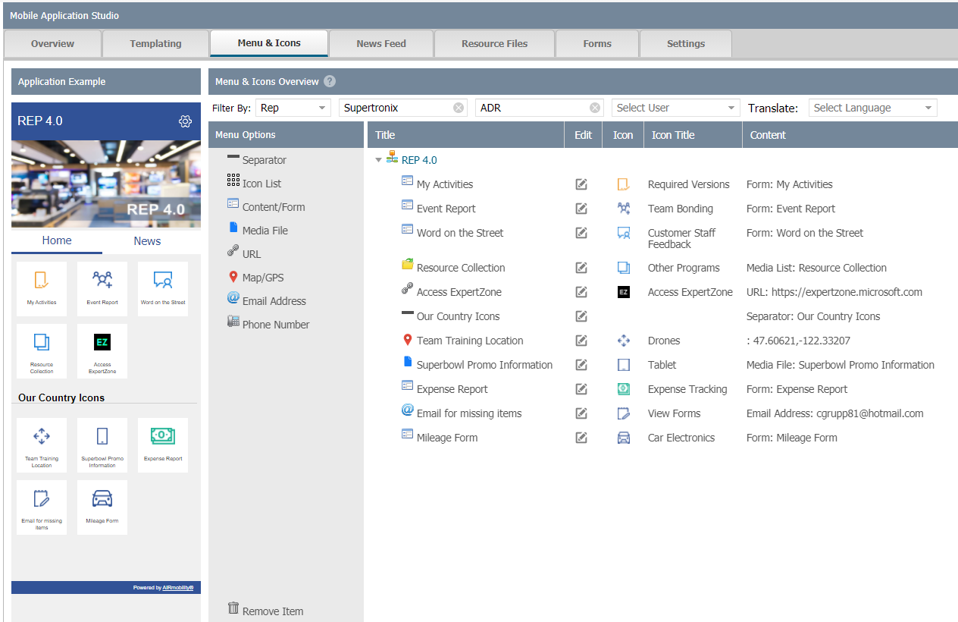
3. App Studio – Menus and Icons – Emulator
The Emulator enables you to see a visual representation of what a partner might see as well as who is assigned what icon and in what view. For example, you may have a document for one partner and a similar but different document for another partner. You can load both documents and then assign them separately in the studio. Then use the drop down menus below to get a better view/visual of what is being provided.
As you select the Filters* on the previous page, the Titles shown will change along with the Emulator.
The Emulator helps you visualize the general look/feel the Reps will see on their device.
The Emulator is for display; there is no interaction.
*Selection is available for markets / countries with both REP and Champions. Others will not see this.
Copyright © 2001, 2021 Westlake Software, Inc. Portions Copyright Microsoft Corp. All Right Reserved. Confidential Information.

Slide 20
3. App Studio – Menus and Icons - Menu
If you missed this in the tutorial a few pages back, items are repeated here (we suggest not to skip the tutorial). These are the available options/functions you can drag right an add to your title list. The items below reflect the options expected to be available January 2021.
Icon List
Create tiers/levels of icons. Add an icon list and then drag you other icons onto this item. This will place those icons onto a new page. You can go multiple levels down with this.
Separator
This option allows you to title and draw a line above a set of icons. This is technically not an icon but it will help you organize the user experience. When you add, you can also make a bar support a weblink if desired (click her for more info, etc.).
Media File
As you add documents, graphics, etc. to the program, you can assign those resources to an icon. If you were to use the Icon List option above, you could for example (1) make an Icon List called Sales Documents, then support Media File Documents under that icon list.
Phone Number
For iOS and Android user, you can create an icon to dial a phone number. Maybe this is the Rep’s contact at your agency? Numbers to dial other resources. NOTE: in some cases you may need the country code, etc. This has been tested in multiple countries but not all.
Email
This option will open the default email app on your Champ’s device to send an email to a specified address.
Mapping (new)
Enables you to enter in any LAT and LONG coordinates to trigger mapping on any device. We provide a global link to a service where you can type in any street address and enter in the coordinates.
Form/Content
You can assign any form you created to an icon. Forms can now be used to create information/content pages. This is useful for announcements, information, etc. This is covered in a section forward in this document.
Remove Item
Drag an option you created from the Title view BACK to the menus; drop right on Remove Item. This will remove the icon. Note, removing an icon does NOT delete or remove a form; just access to that form as that icon is no longer accessible.
Copyright © 2001, 2021 Westlake Software, Inc. Portions Copyright Microsoft Corp. All Right Reserved. Confidential Information.

Slide 21
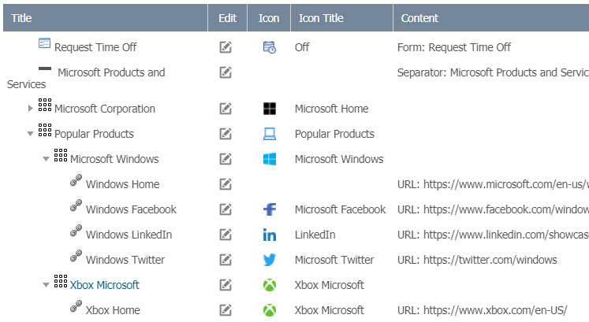


3. App Studio – Menus and Icons - Titles
There are 4 items to know when working with Titles:
You can drag new items in from the menu and drag unwanted items out/remove back to the menu
You control order. Grab any item with you mouse and move it up and down the list
If you use Icon Lists, the menu will ident to help you visualize your work (like an outline)
Expect to go in and out of settings icon; mainly to denote who is opted in and out of each icon (detail next page)
Issue | Resolution
I added a new menu item, and it looks like it is gone. | It’s probably not gone. The drag and drop spot was off and it likely moved it to the bottom. You can drag it from the bottom and put it anywhere you want. If you mouse support scroll. Hold and Scroll works best.
My icons are not inside of an Icon List. It looks wrong on the device | As your app view becomes more elaborate, it is common to accidently mis-drag an item to the wrong Icon List or not make the list all together. Resolved by re-dragging to the correct location.
Trying to drag a new menu but keep getting an X display. | Placement is sensitive. Drag slower between items to get the plus option.
Copyright © 2001, 2021 Westlake Software, Inc. Portions Copyright Microsoft Corp. All Right Reserved. Confidential Information.

Slide 22
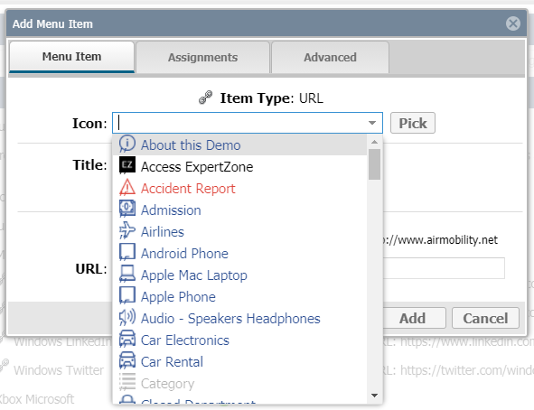
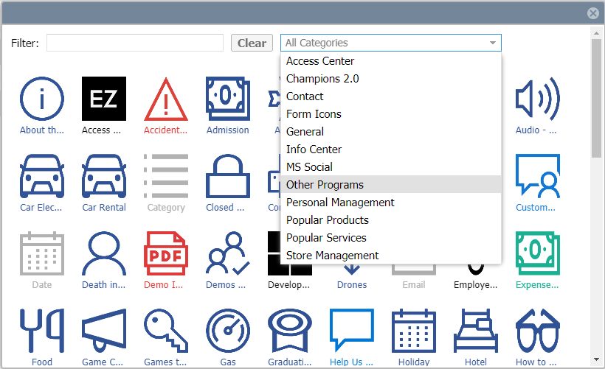
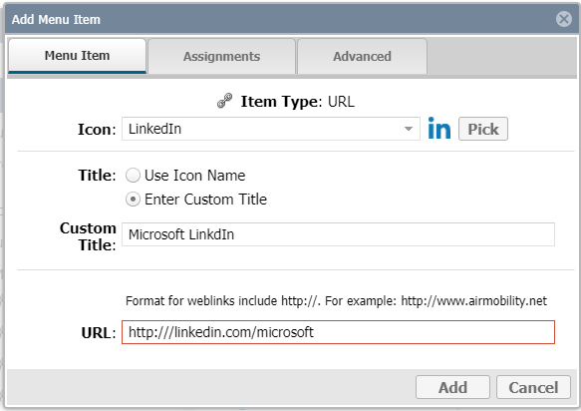
3. App Studio – Menus and Icons – Title Settings
Once you drag a menu item into the title section, a pop-up box will display where you are required to make some selections about the new icon.
Tab 1 – Menu Item
Pick and icon to use. Drop down, Pick from Gallery, In Gallery, pick from Category.
Provide a title for that icon. Use the Icon title or create your own.
Enter or Select the attribute needed. URL needs a web link, Phone Number needs a number, etc.
NOTE – Instructions and tips are provided to assist on many of the pages.
Copyright © 2001, 2021 Westlake Software, Inc. Portions Copyright Microsoft Corp. All Right Reserved. Confidential Information.

Slide 23
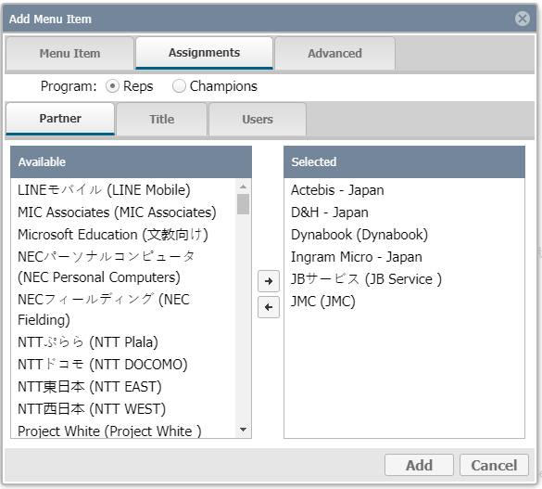
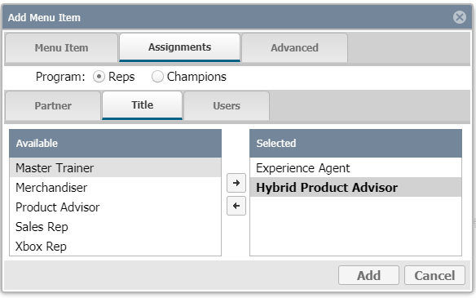
3. App Studio – Menus and Icons – Title Settings
Tab 2 – Assignments
Pick REP or Champions*
Select Partner, Title (or Users if desired)
Drag Partners/Titles/Users from the Available list on the left and drop them into the Selected list on the right
Click Add / Save
Reminder: Each tab updates based on hierarchy (moving left-to-right).
*Selection is available for markets / countries with both REP and Champions. Others will not see this.
Copyright © 2001, 2021 Westlake Software, Inc. Portions Copyright Microsoft Corp. All Right Reserved. Confidential Information.

Slide 24
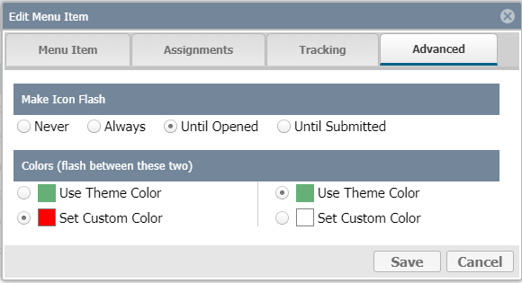
3. App Studio – Menus and Icons – Title Settings
Tab 3 or 4 (depending on your view) – Advanced
Advanced allows you to make and icon flash/pulse between two colors. Options include:
Never – Default, Icon does not flash/pulse
Always – Always is flashing/pulsing
Until Opened – Flashes/pulses until the user clicks on the icon
Until Submitted – For form submission. Works until a form is submitted
Copyright © 2001, 2021 Westlake Software, Inc. Portions Copyright Microsoft Corp. All Right Reserved. Confidential Information.

Slide 25
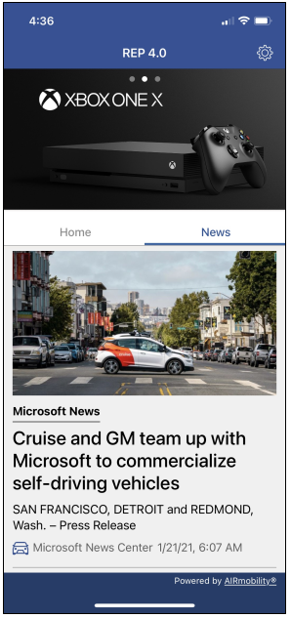
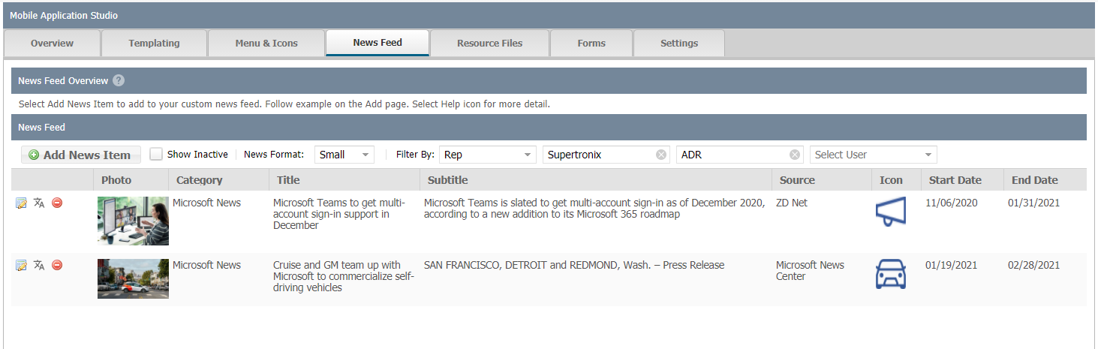
3. App Studio – News Feed Overview
Create your own News Network for each Partner
News feed is designed to keep the REP program more interesting. It’s not a form to submit or a content form (covered later) and not a push notification. Modeled after Microsoft News, this option is excellent for general announcements, product announcements and anything else that feels like news you wish to communicate to your Reps.
Administration Drop Down >> App Studio >>News Feed tab.
Copyright © 2001, 2021 Westlake Software, Inc. Portions Copyright Microsoft Corp. All Right Reserved. Confidential Information.

Slide 26
3. App Studio – News Feed - Fields
Creating your first News Article
Before you attempt to add your first article, we recommend you have these items ready to go first and prepped the following way. This will save you time and make creating the article easer. Some items are optional but the more items you use, the more feature rich and more interesting your articles will look.
Item | Description
1. Title (required) | Phrase/Sentence to catch the attention of the reader.
2. Subtitle (optional) | Secondary line such as: (Title) New Windows Release (Subtitle) Expected to Provide High Level Security
3. Body (required) | Prepare in MS Word. You can add URL links; they will be live. NOTE: when you paste into the system, you may need to do some slight re-formatting, but will only take a minute to do this (paragraphs, spacing, etc.).
4. Graphic (optional) | Highly recommended – prepare a graphic size 4 X2, keep close to or near 100K in size.
5. Category (optional) | You can add a list and pick from that list as you go. Just adds interest to an article.
6. Source (optional) | Was this from your agency? Microsoft? MSN? This adds more color/interest to your article.
7. Source Icon (optional) | You can place a small icon next to the source to make that look more interesting.
8. Start and End Date (optional) | Do you want this article to always be active or start and end on a certain date?
9. Display Date (optional) | Allows you to control the date that is displayed with the article.
9. Assignments (required) | Who are you going to assign this article to? Reps at a certain partner? Certain titles?
Copyright © 2001, 2021 Westlake Software, Inc. Portions Copyright Microsoft Corp. All Right Reserved. Confidential Information.

Slide 27
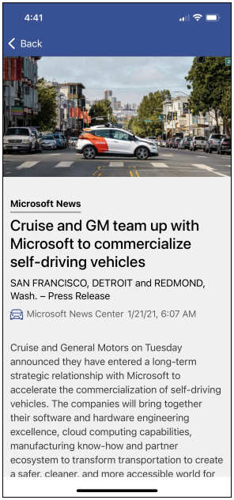
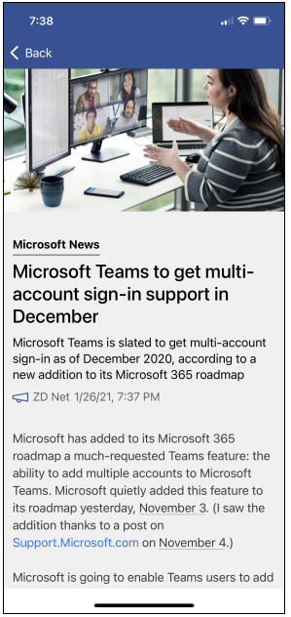
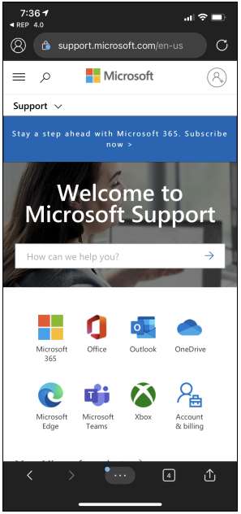
3. App Studio – News Feed – App Display
If you use everything required and optional from the previous page:
4 X 2 Graphic, 100K
Category
Title
Subtitle
Icon
Source
Display Date
Body
Embedded Link
Copyright © 2001, 2021 Westlake Software, Inc. Portions Copyright Microsoft Corp. All Right Reserved. Confidential Information.

Slide 28
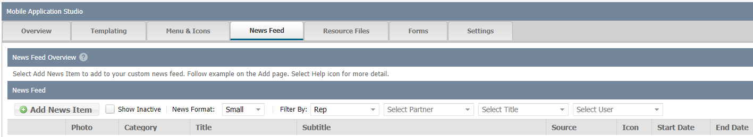
3. App Studio – News Feed General
Select Add News Item to start:
Two formats for your news. All news needs to be one way or the other. See next page to view what these formats look like.
Once you start adding news items, these drop down filters are used to help you see who has been assigned what news items by program, partner, title or user.
Copyright © 2001, 2021 Westlake Software, Inc. Portions Copyright Microsoft Corp. All Right Reserved. Confidential Information.

Slide 29
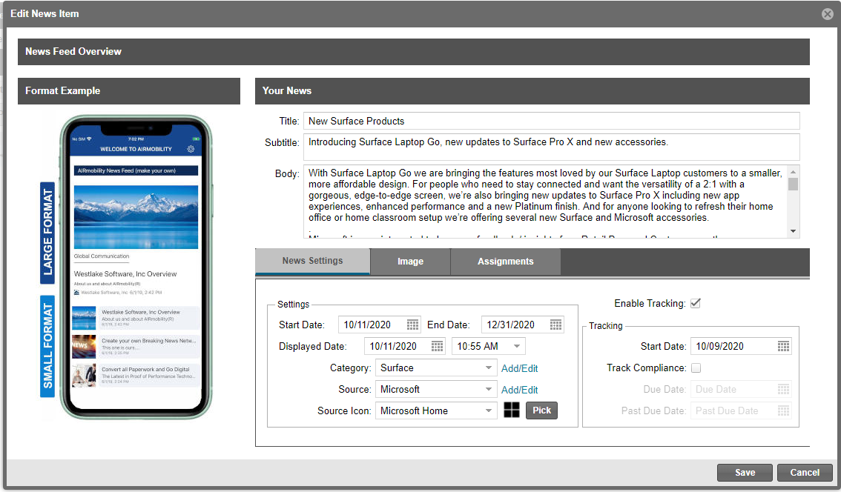
3. App Studio – News Feed Format
Enter in (or cut and paste) your content, format the body section, Save.
Title
Subtitle
Body
Small News format; Large News Format
Not Available; feature coming soon.
See breakout detail in next page.
When done, click Save.
Start & End Date
Display Date
Category
Source Icon
Source
Pick form a Gallery of Available Icons
Copyright © 2001, 2021 Westlake Software, Inc. Portions Copyright Microsoft Corp. All Right Reserved. Confidential Information.

Slide 30
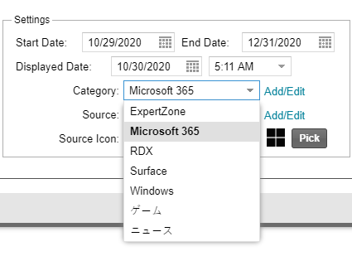
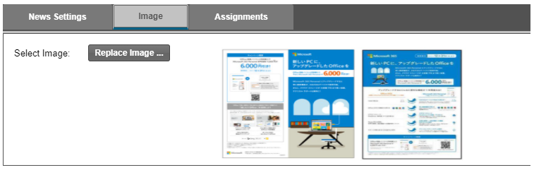
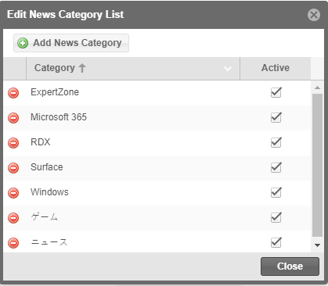
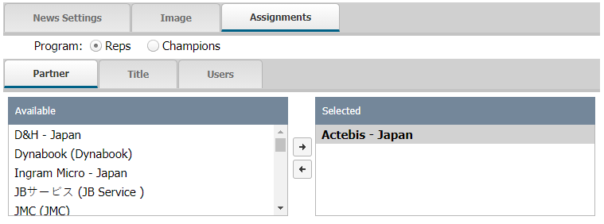
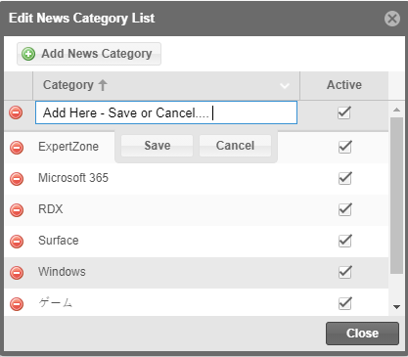
3. App Studio – News Feed Format (2)
Image Tab – Upload your 4 X 2, 100K or less in size graphic/image here.
You can build your own drop down of reusable Categories and Sources.
Select the Add/Edit Link.
Assignments Tab – Select Program (Reps). Then choose if you want this for a particular partner, title or by users. Double click/drag item from left to right to assign. Right to left to un-assign.
Select Add News Category or Select Add New Source. Enter them and Save.
Copyright © 2001, 2021 Westlake Software, Inc. Portions Copyright Microsoft Corp. All Right Reserved. Confidential Information.

Slide 31
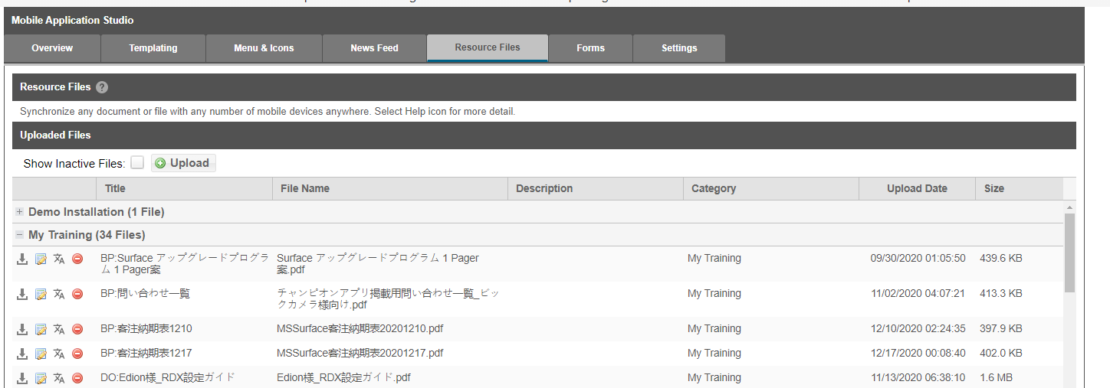
3. App Studio –Resource Files - Overview
The App Studio now supports a quicker/easier way to manage Resource Files.
There is also substantial flexibility in assigning the files you add here to icons you create in Menus and Icons.
To Assign a resource file to an icon and assign who sees/gets that file we suggest to walk through the tutorial. In addition to the Resource Files Directory, you can now assign a file its own icon.
The next set of slides only covers the new way of adding files to the system.
Select the Upload button to Upload a Resource File. Supported file types:
PDF
DOC
XLS
JPG
BMP
PPT
WAV
MP4
If the device (Android, iOS, etc.) supports the file type, it will work.
Copyright © 2001, 2021 Westlake Software, Inc. Portions Copyright Microsoft Corp. All Right Reserved. Confidential Information.

Slide 32

3. App Studio –Resource Files - Warning
READ THIS FIRST
It is important to be realistic with the size and number of files in which you are synchronizing with a mobile device.
For example, we had a video that was over 100MB in size being pushed to the app over a 2G cellular network. Not only would this take over an hour, in most cases the file would not load and stall the app in the process.
There is no set limit to the number of files you can push to the app. As you add files please consider the following:
Can you make the files/documents smaller?
Can you provide the user a link online to the document versus synchronize?
Does the volume and sizes seem to be realistic with the devices deployed?
Wi-Fi and/or cellular network considerations?

Slide 33
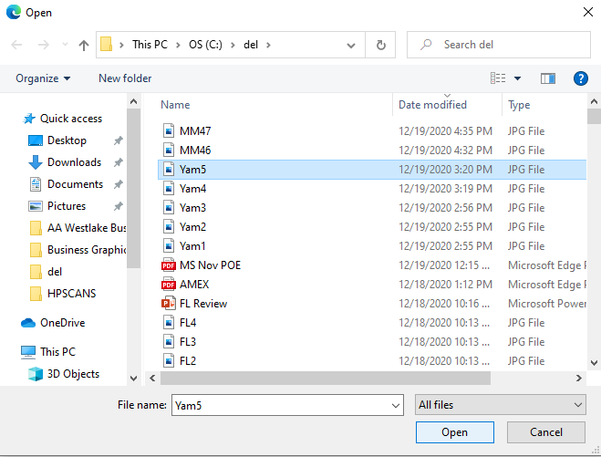
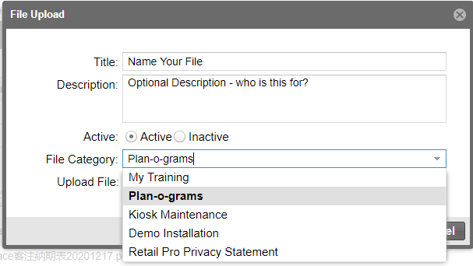
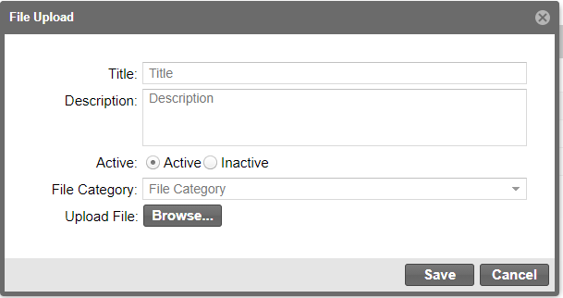
3. App Studio –Resource Files
1. Title – name your file
2. Description (optional)
3. Active – File that can be seen
Inactive – not deleted but not available to be seen
4. Select a File Category
5. Browse – triggers standard upload box
6. Select a file, select Open (Edge/Windows)
7. Save
Copyright © 2001, 2021 Westlake Software, Inc. Portions Copyright Microsoft Corp. All Right Reserved. Confidential Information.

Slide 34

3. App Studio – Content Forms
Forms tab is a place to create your own forms. This follows the form building model country admins are already familiar with in the Call Report Manage and Create functions. If you are not familiar with this section, please contact region lead or Msftreps@microsoft.com for more information.
NEW FEATURE – Content
By selecting content
The form removes Submit button
The form removes “Save” question when moving backwards
Why would I want to use this? New creative way of adding a variety of content to an icon.
Some Content Ideas
Description of a service/location + picture and Address (address is a hot link to device maps for directions) | List of Reps/contacts with phone numbers (numbers will be live links and dial)
Training – ancillary training advice/imbedded docs | Directory – use conditional logic to pick items, then show content
Blog – story out an experience. Running Text… | Short description + coupon graphic
Rankings – keep track of something interesting | Top 5 thoughts of the day
Copyright © 2001, 2021 Westlake Software, Inc. Portions Copyright Microsoft Corp. All Right Reserved. Confidential Information.

Slide 35

3. App Studio – Content Forms
Click on Create/Create New Form from the App Studio:
App Studio >> Forms Tab >> Create New Form Button
Copyright © 2001, 2021 Westlake Software, Inc. Portions Copyright Microsoft Corp. All Right Reserved. Confidential Information.

Slide 36

3. App Studio – Content Forms
Select Style as Content Page
Click next… start your content
Common Mistake/Easy Fix
If you noted a form for submission as Content or Content a form for submission, you can go back and change this by selecting the other style.
How do you know you make a mistake?
Your content has a Submit button and when you click back it asked for you want to save.
Your form has no submit button and the user can not save.
Copyright © 2001, 2021 Westlake Software, Inc. Portions Copyright Microsoft Corp. All Right Reserved. Confidential Information.

Slide 37







3. App Studio – Content Form Examples
Copyright © 2001, 2021 Westlake Software, Inc. Portions Copyright Microsoft Corp. All Right Reserved. Confidential Information.

Slide 38

3. App Studio – Settings
Settings option supports a default studio page if you find yourself going to particular page more often (such as the Menus & Icons page). Additional Settings items will be added as the system grows.
Copyright © 2001, 2021 Westlake Software, Inc. Portions Copyright Microsoft Corp. All Right Reserved. Confidential Information.

Slide 39

Admin Preview for simulating a REP 4.0 user
To view what a specific Rep is seeing on the app:
Works on REP 4.0 apps only
Provides “Read only” access (will not submit a report)
Enter 999 prefix plus the Rep’s 10-digit ID
No password needed
Click “Sign In”
Copyright © 2001, 2021 Westlake Software, Inc. Portions Copyright Microsoft Corp. All Right Reserved. Confidential Information.

Slide 40
Contact Information
General Support and Questions (24/7):
Msftreps@westlakesoftware.com
Christopher Grupp
Westlake Software, Inc.
Christopher.grupp@westlakesoftware.com
Tel.: +1 (206) 334-0753
Alan Gould
Westlake Software, Inc.
Alan.gould@westlakesoftware.com
Tel.: +1 (818) 991-9988
Copyright © 2001, 2021 Westlake Software, Inc. Portions Copyright Microsoft Corp. All Right Reserved. Confidential Information.

