Slide 1
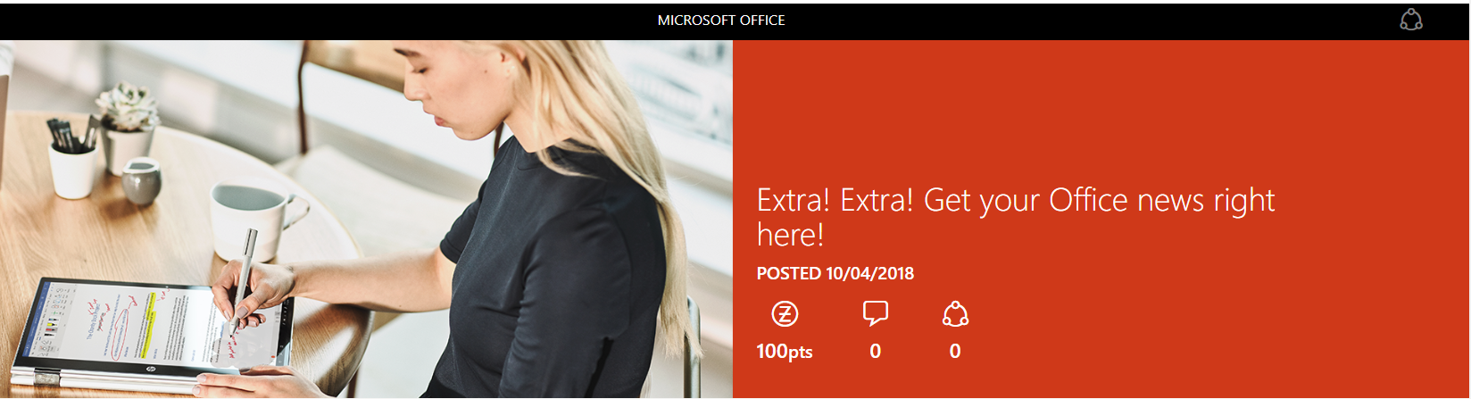
Office 2019 is here! Plus, what's new about Office 365? Let's take a look...

Slide 2
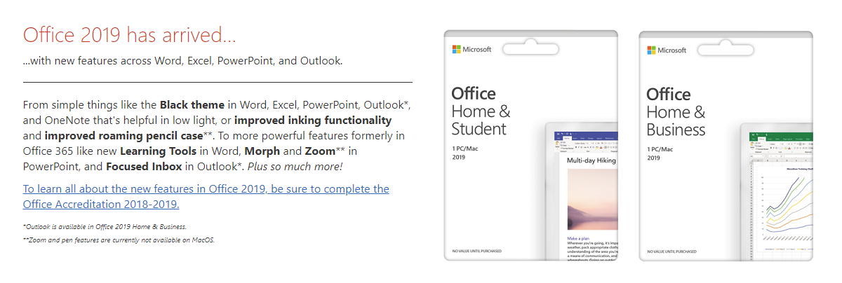

Slide 3
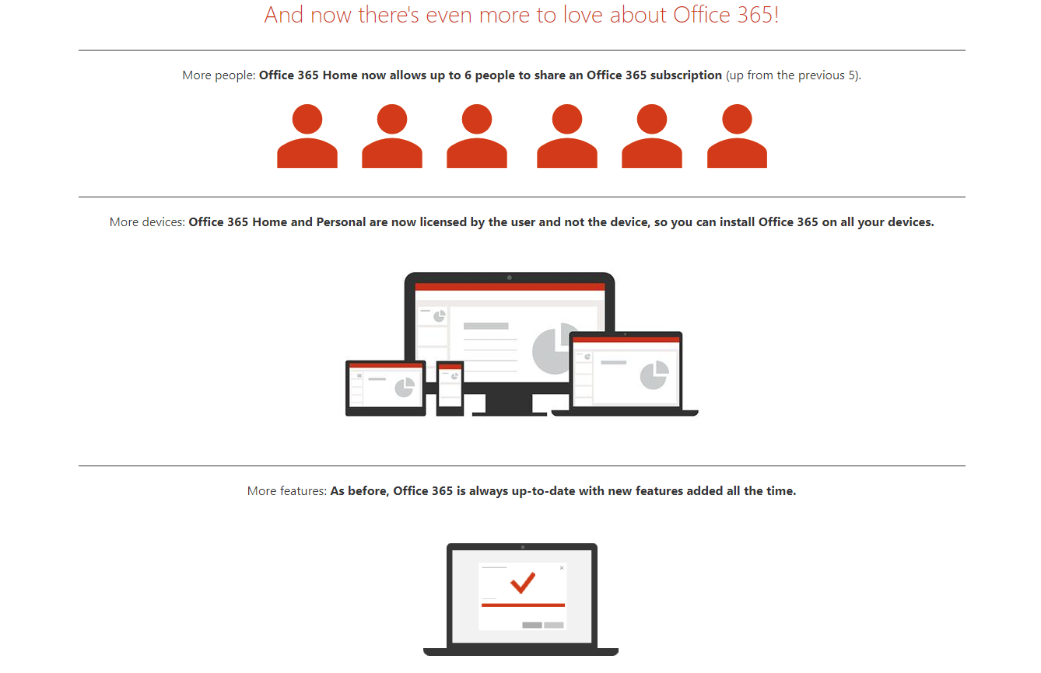

Slide 4
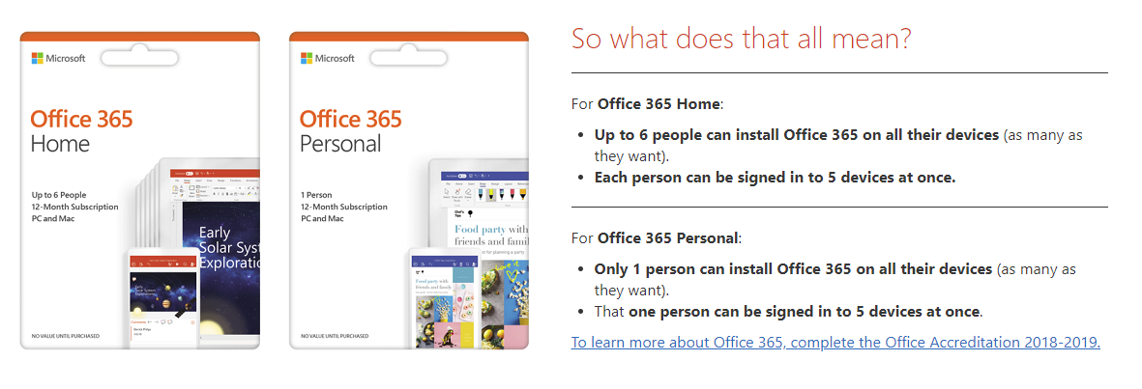

Slide 5
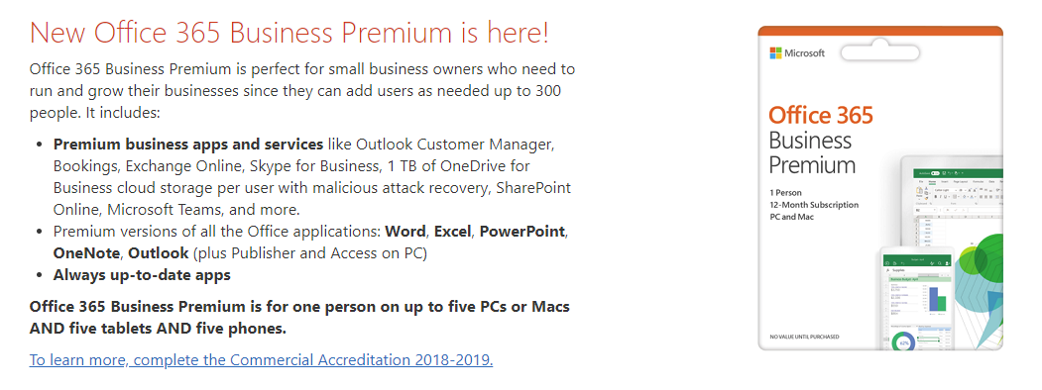
Want to get yours, while you learn how to help your customer get theirs?
Sounds like a win-win to me! Complete the Office Accreditation 2018-2019 and you'll receive your own 6-month code for Office 365, so you can take advantage of the best that Office has to offer, too.

