Slide 1
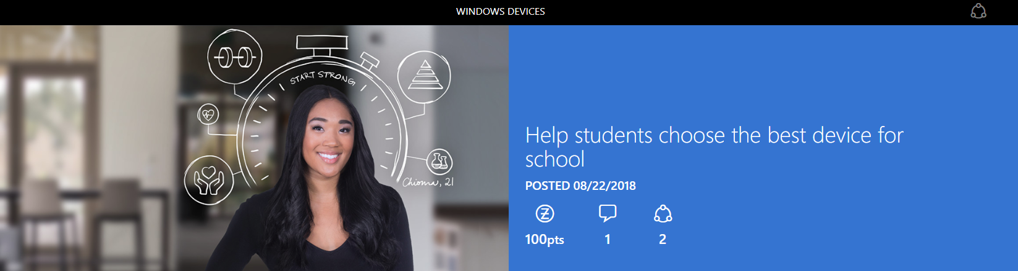
The experience for students today...
is much different than in the old days of endless paper and smudged chalk.From the classroom to the cafeteria to the park and back again, staying connected and being productive from anywhere isn't just a want, it's a need.

Slide 2
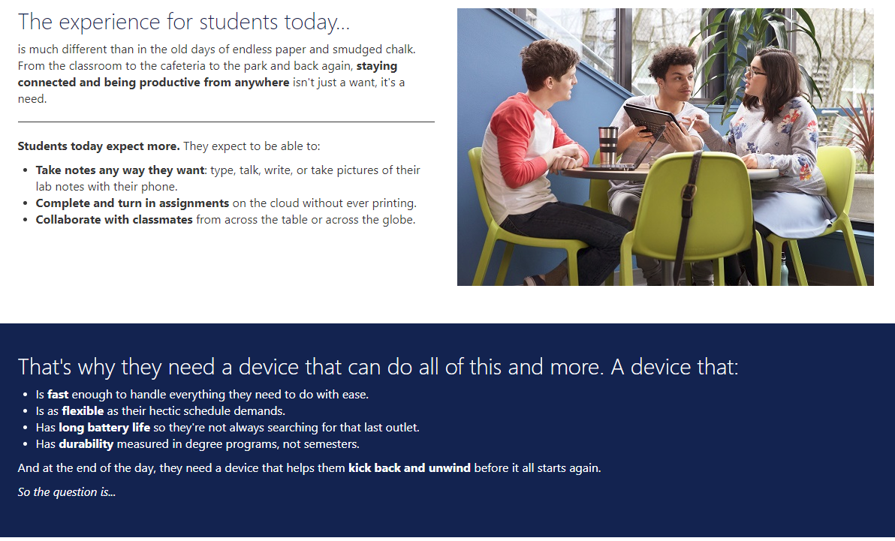

Slide 3
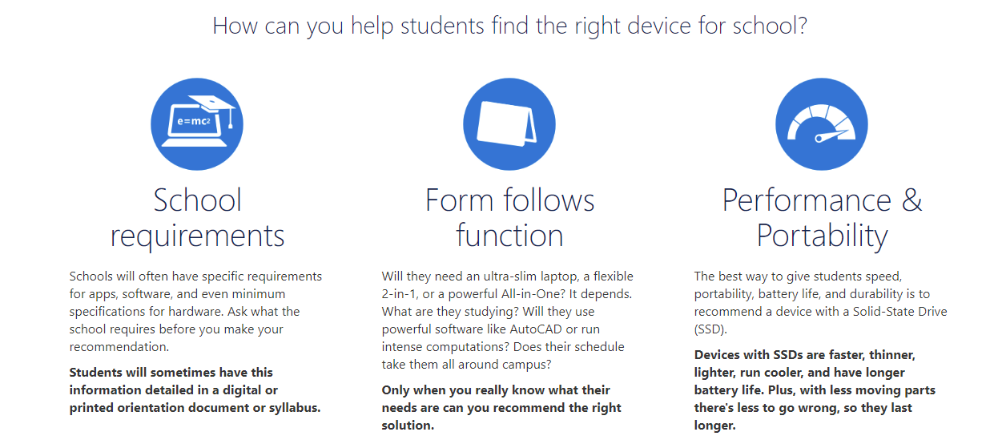

Slide 4
