Slide 1
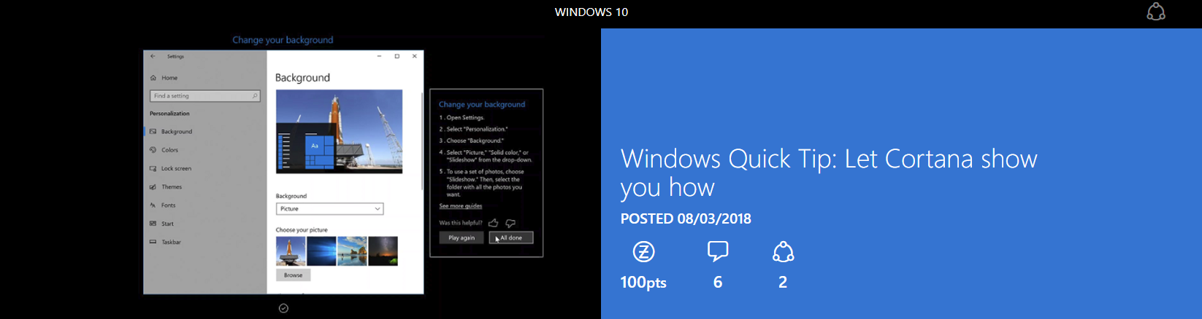
Using the Cortana Show Me app

Slide 2
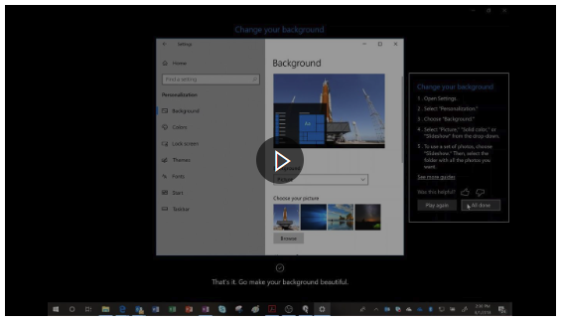
Cortana Show Me app
If you're anything like me...
you're constantly getting asked for computer assistance by friends and family. From fixes to a problem, to simply helping them with a setting. It never seems to end. I'm always looking for ways to make the whole process easier for me and my family.
This new app is designed...
to help anyone who needs a little assistance in getting things done on their PC. Little things, like changing the desktop background or display brightness, or even things like connecting to Wi-Fi or adding a Bluetooth device.

Slide 3
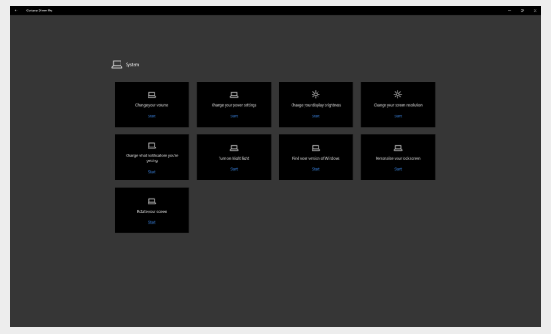
Cortana Show Me app
Cortana Show Me guides you step by step through Settings
This isn't just another set of screenshots or how-to videos. Cortana Show Me actually takes control and brings you right to the spot you need, all while Cortana's voice assistant guides you along. Since launching with 15 guides, Cortana Show Me can now assist you with 38 different tasks, including:

Slide 4
Cortana Show Me app
Of course the Cortana Show Me app probably wasn't designed to help you, our experts.
But that's not the point. If you have anyone in your life that could use a little extra help on their PC now and then, Cortana Show Me can help. And not only that, the Cortana Show Me app is a great recommendation for after a sale. If you have a customer who you think might need some assistance when they get home, show them (or help them install) the Cortana Show Me app.
It's the perfect way to provide over-the-top service after the sale, and avoid frustration for you and them on all those little things that the Cortana Show Me app can help solve.

