Slide 1
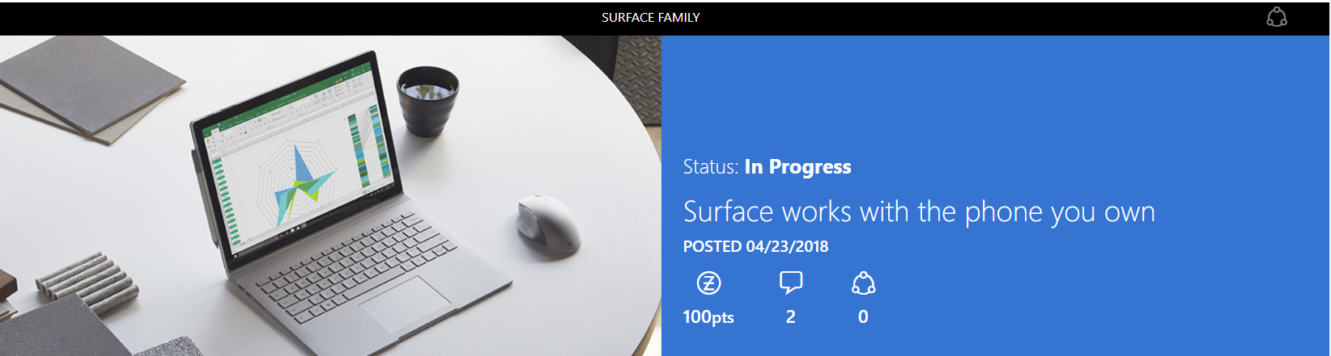

I am, and always will be, a phone guy…
I’ve talked in the past about how my first "big-kid job" was spending 10 years working at T-Mobile here in the U.S. Cell phones quickly became my newest tech obsession as I was indoctrinated into the wireless industry. And the moment it kicked into high gear was when I purchased the first Android phone, the T-Mobile G1.
Here's the thing, though: I’m also obsessed with my Surface. What I love is that I don't have to choose between my two obsessions! My phone, the apps and services I rely on, and my Surface work brilliantly together. No matter what, Surface works with the phone you own.

Slide 2
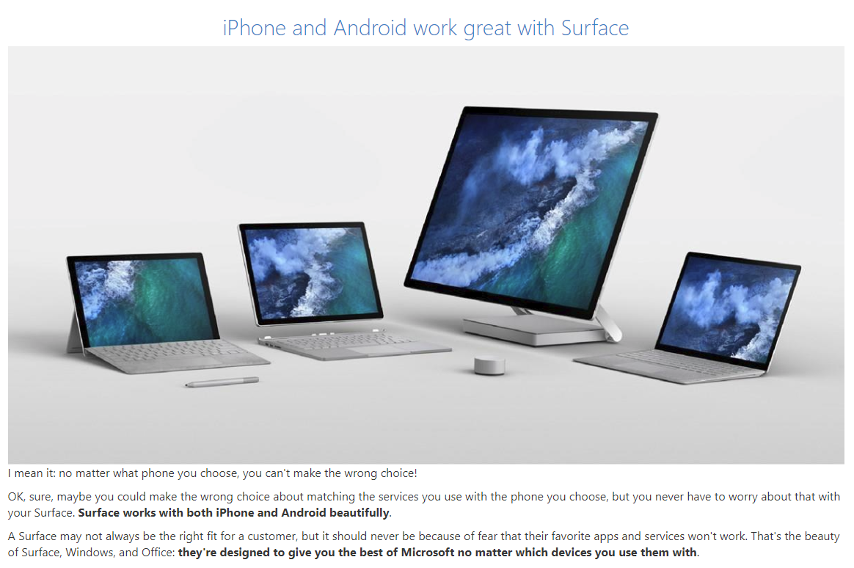
What apps and services work with Surface?

Slide 3
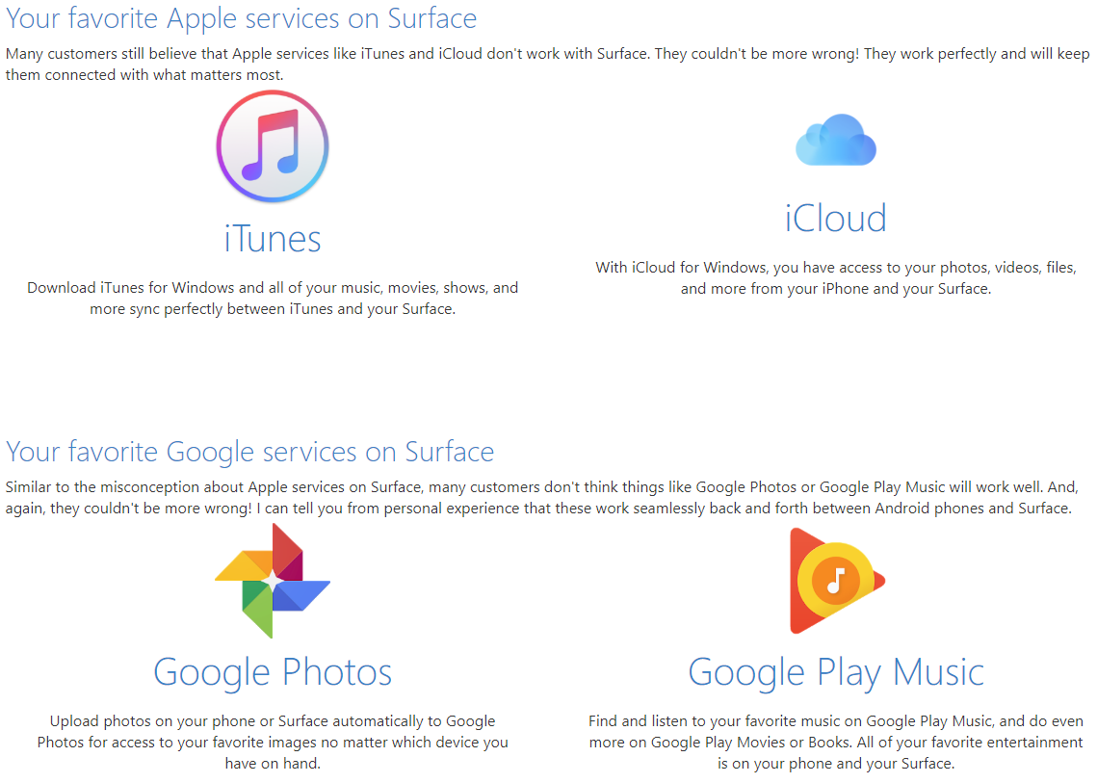
What apps and services work with Surface?

Slide 4
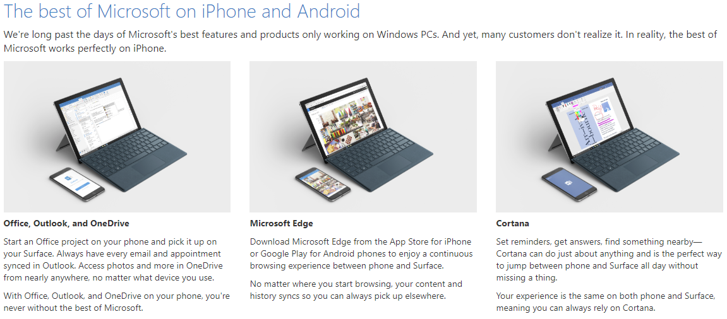
How do Microsoft apps and services work with my phone?

Slide 5
Never a wrong choice with Surface.
Whether you're choosing an iPhone because you adore the iconic status or choosing an Android phone because you can get the perfect phone, OS, and apps for you, you're likely choosing to ensure your phone works with the services you use. And while you have to do that with a phone, you never have to worry if it will work with Surface.
The most popular apps and services from each—things like iTunes, iCloud, Google Photos, and Google Play Music—all work with Surface. And the best of Microsoft like Office, Outlook, OneDrive, Edge, and Cortana all work with either phone. These are just a few examples of how they work brilliantly together, too!
Remind customers of that when they're considering a Surface, because, believe it or not, it's often something we find customers concerned about and a big influence on their purchase decision. Make sure they know: Surface works with the phone they own.

