Slide 1
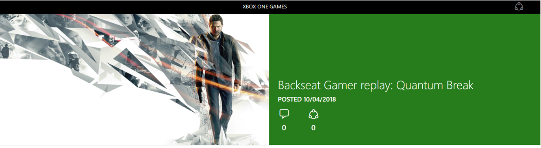
We hope you'll join us on Tuesday, November 6, at 5 p.m. Pacific Time for the next episode of Backseat Gamer. As always, the next featured game will be chosen from the 100+ titles in the Xbox Game Pass library.

Slide 2
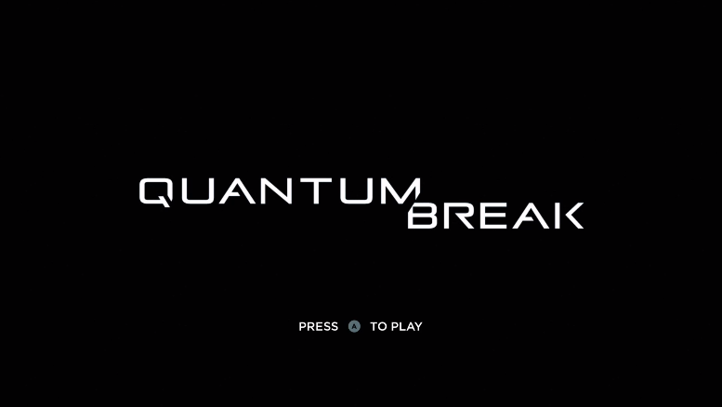
Backseat Gamer: Quantum Break (Part 1)
In this episode of Backseat Gamer, we dive into the opening act of Quantum Break, the cinematic sci-fi adventure from Remedy Entertinment (Max Payne, Alan Wake). Part 1 features the opening cinematic sequence. The game's intro begins at 4m 47s.

Slide 3
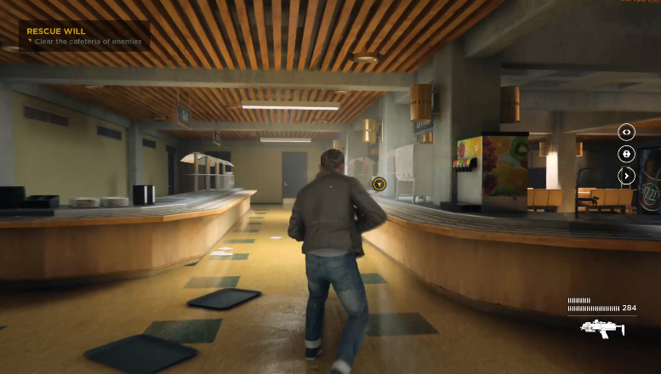
Backseat Gamer: Quantum Break (Part 2)
Part 2 features time-bending combat, the first "Junction Point" (where we make a key decision that changes the way the story unfolds), and the opening scenes of the live action show.

