Slide 1

Heavy hitters in October
Wanted this October: elite performers! Become a master chef in Overcooked, a deadly Specialist in Call of Duty: Black Ops 4, or a racing superstar in Forza Horizon 4. You can even be among the first to emerge from Vault 76 in the Fallout 76 B.E.T.A, coming first to Xbox One.

Slide 2

News beats

Slide 3

News beats

Slide 4

Releasing this month

Slide 5
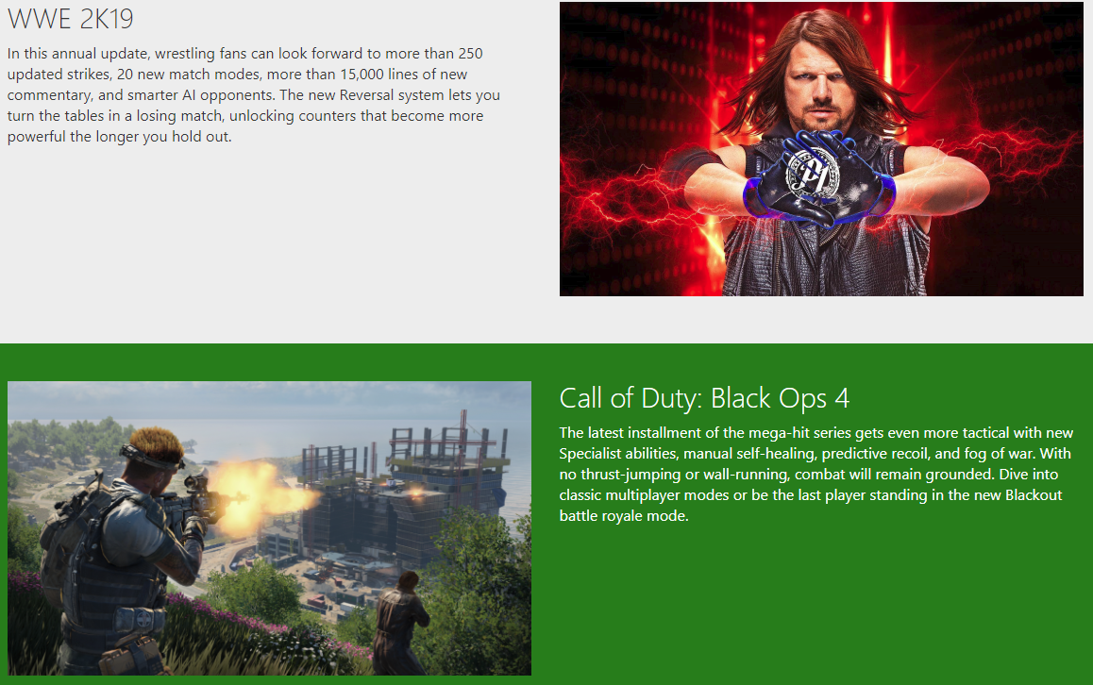
Releasing this month

Slide 6

Releasing this month

Slide 7
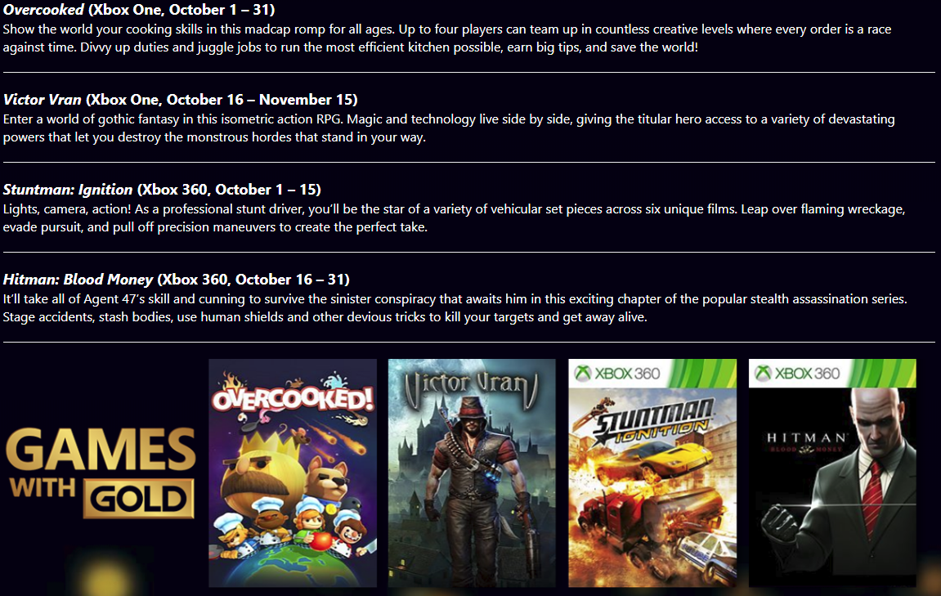
Games with Gold

Slide 8
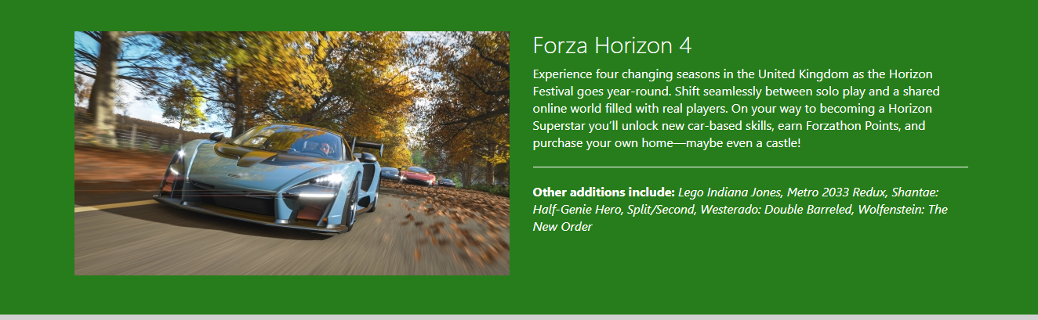
Arrivals on Xbox Game Pass

